Slide 1
Managing your metadata with Project Egeria

Slide 2
Agenda
6:00pm Networking
6:30pm Kick-Off
John Mertic - Linux Foundation Director of Program Management
6:45pm Why Open Metadata
Mike Nicpan - ING Information Architect
7:15pm Project Egeria
Mandy Chessell - IBM Distinguished Engineer, Master Inventor, Fellow of Royal Academy of Engineering
8:00pm Networking
8:30pm Close

Slide 3

John Mertic
Linux Foundation Director of Program Management

Slide 4

Mike Nicpan
ING Information Architect

Slide 5
Realizing open metadata and governance
Open Metadata and Governance
Delivering core technology
Recruiting vendors
Assisting practitioners
Core Technology
Vendors
Project
Egeria
Compliance Suite
Practitioners
Best Practices
Project
Data
Governance

Slide 6
Design philosophy
Use cases,
Personas,
Practitioners
input
Search
Open Metadata Access Services
Open Metadata Repository Services
Data integration, availability and integrity best practices

Slide 7
Coco Pharmaceuticals persona
https://odpi.github.io/data-governance/coco-pharmaceuticals/personas/

Slide 8
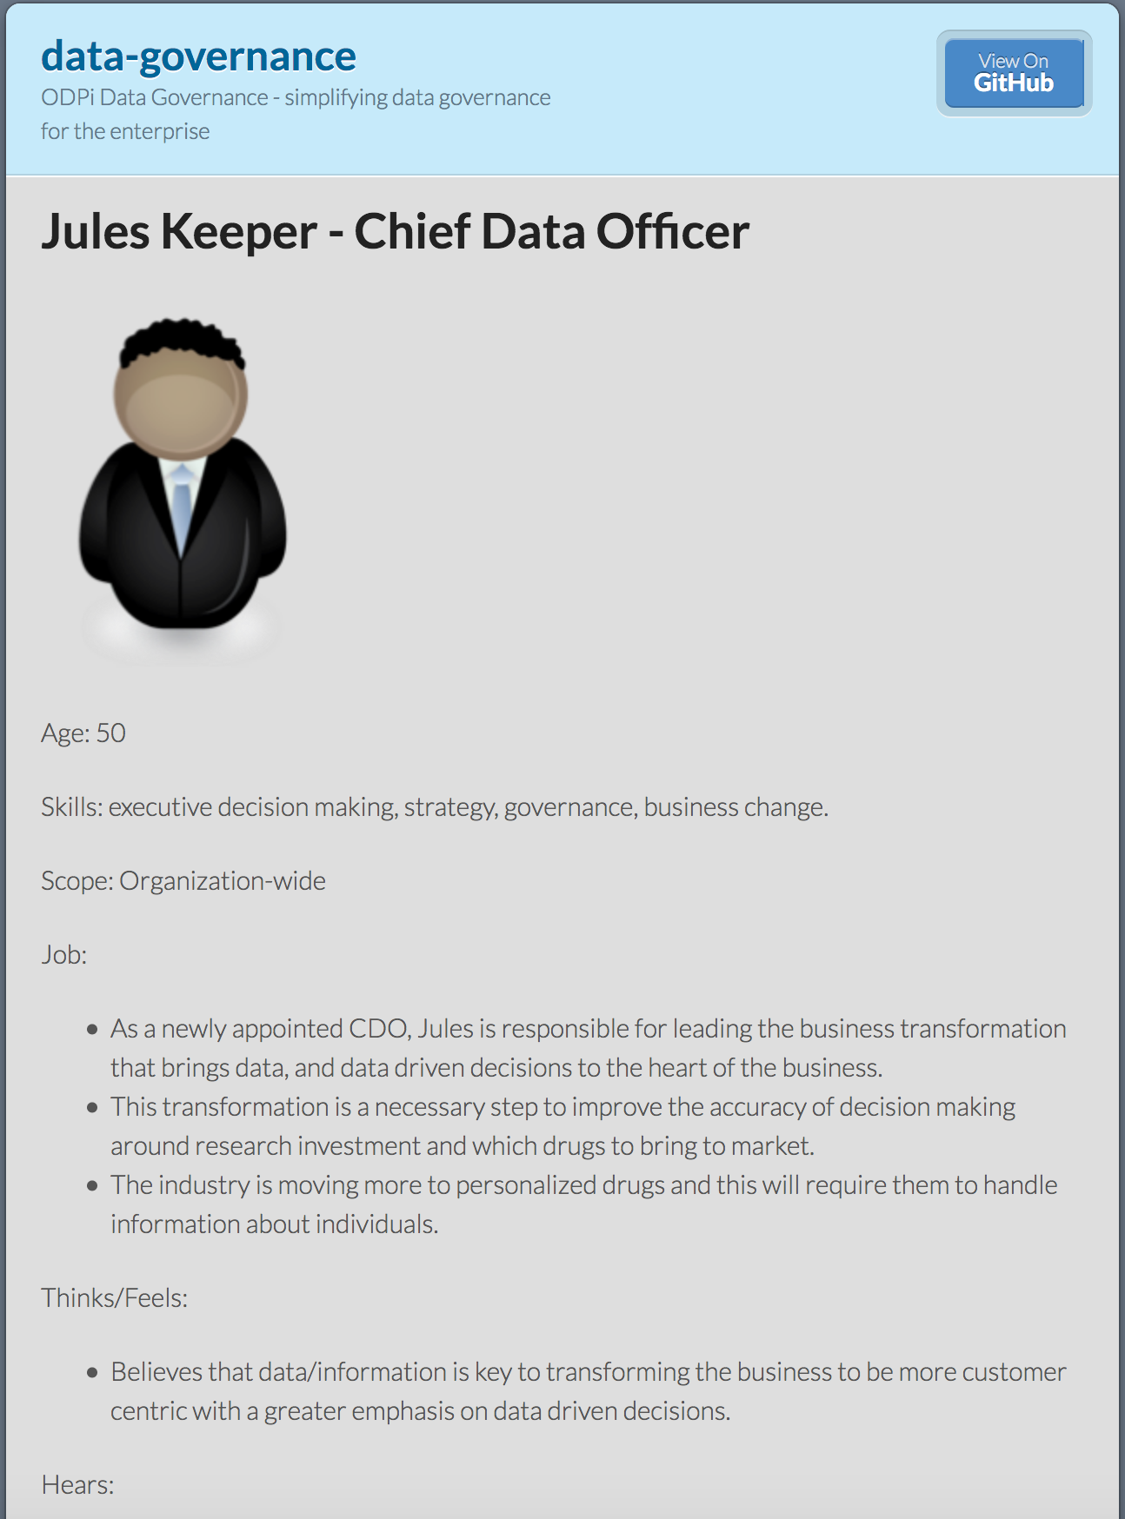
Using design thinking
Open Metadata Types
Access Service Identification
Samples and API design
Best Practices

Slide 9
How do you share metadata?

Slide 10
Open metadata type model summary
Governance
Glossary
Collaboration
Models and
Reference Data
Lineage
Metadata
Discovery
Data Assets
Base Types, Systems
and Infrastructure

Slide 11
Each area caters for appropriate metadata structures
Strategy
4
Subject Area Definition
1
Teaming Metadata
(people profiles, communities, projects,
notebooks, …)
Policy Metadata (Principles, Regulations, Standards, Approaches, Rule Specifications, Roles and Metrics)
Business Objects and Relationships, Taxonomies and Ontologies
Augmentation
3
Organization
Feedback Metadata
(tags, comments, ratings, …)
Rollout
Classification
Business Attributes
Campaigns and Projects
Classification Schemes
Implementation
Mapping
Governance Actions and Processes
Rights
Management
Models and Schemas
2
Asset Collections
(Sets, Typed Sets, Type Organized Sets)
Reference Data
5
Instrument
7
Information Process
Instrumentation (design lineage)
Association
Information Views
Augmentation
Discovery
Metadata (profile data, technical classification, data classification,
data quality assessment, …)
Physical Asset Descriptions
(Data stores, APIs,
models and components)
0
Basic Types, Infrastructure and Systems
Access
6
Connectors

Slide 12
Implementing the open metadata types
Search
Domain
Specific
Open Metadata Access Services
Open Metadata Repository Services
Domain
Agnostic

Slide 13
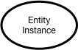
Instance representations in the repository services

Slide 14
Through the Repository Services
{
"class": "EntityDetailResponse",
"relatedHTTPCode": 200,
"entity": {
"class": "EntityDetail",
"type": {
"class": "InstanceType",
"typeDefCategory": "ENTITY_DEF",
"typeDefGUID": "578a3510-9ad3-45fe-8ada-e4e9572c37c8",
"typeDefName": "GovernanceOfficer",
"typeDefVersion": 1,
"typeDefDescription": "Person responsible for a governance domain.",
"typeDefSuperTypes": [
{
"guid": "a32316b8-dc8c-48c5-b12b-71c1b2a080bf",
"name": "Referenceable"
}
],
"validInstanceProperties": [
"qualifiedName",
"additionalProperties",
"title",
"scope",
"domain"
]
},
"createdBy": "julesk",
"createTime": "2018-09-11T13:01:20.139+0000",
"version": 1,
"instanceProvenanceType": "LOCAL_COHORT",
"metadataCollectionId": "87b06ffe-9db2-4ef5-ba6e-8127480cf30d",
"guid": "fd7d41e7-70f5-42ec-86d3-88683e599494",
"instanceURL": "http://localhost:8080/instances/entity/fd7d41e7-70f5-42ec-86d388683e599494",
"properties": {
"class": "InstanceProperties",
"instanceProperties": {
"title": {
"class": "PrimitivePropertyValue",
"instancePropertyCategory": "PRIMITIVE",
"primitiveDefCategory": "OM_PRIMITIVE_TYPE_STRING",
"primitiveValue": "Chief Data Officer (CDO)"
},
"qualifiedName": {
"class": "PrimitivePropertyValue",
"instancePropertyCategory": "PRIMITIVE",
"primitiveDefCategory": "OM_PRIMITIVE_TYPE_STRING",
"primitiveValue": "EXEC-CDO"
},
"domain": {
"class": "EnumPropertyValue",
"instancePropertyCategory": "ENUM",
"ordinal": 1,
"symbolicName": "Data",
"description": "The data (information) governance domain."
}
},
"propertyNames": [
"qualifiedName",
"domain",
"title"
],
"propertyCount": 3
},
"status": "ACTIVE"
}
}
http://localhost:8080/open-metadata/repository-services/users/julesk/instances/entity/fd7d41e7-70f5-42ec-86d3-88683e599494
Type
Control
Properties

Slide 15
Through the Governance Program OMAS
{
"class": "GovernanceOfficerResponse",
"relatedHTTPCode": 200,
"governanceOfficer": {
"class": "GovernanceOfficer",
"guid": "fd7d41e7-70f5-42ec-86d3-88683e599494",
"type": "GovernanceOfficer",
"title": "Chief Data Officer (CDO)",
"governanceDomain": "DATA",
"appointmentId": "EXEC-CDO",
"appointee": {
"guid": "0760ac98-69e2-4309-ab1d-53377b105d0a",
"type": "GovernancePost",
"profile": {
"guid": "053435b5-b19f-434d-bdd5-f6c909f55cb3",
"type": "Person",
"employeeNumber": "026",
"fullName": "Julian Keeper",
"knownName": "Jules Keeper",
"jobTitle": "Chief Data and Privacy Officer",
"jobRoleDescription": "Ensuring CocoP makes the best use of data.",
"additionalProperties": {
"ContactType": "Employee",
"WorkLocation": 2
}
}
}
}
}
http://localhost:8080/open-metadata/access-services/governance-program/users/julesk/leadership/governance-officers/fd7d41e7-70f5-42ec-86d3-88683e599494
Governance Officer
Governance Post
Person

Slide 16
A relationship
{
"class": "RelationshipResponse",
"relatedHTTPCode": 200,
"relationship": {
"class": "Relationship",
"type": {
"class": "InstanceType",
"typeDefCategory": "RELATIONSHIP_DEF",
"typeDefGUID": "4c4d1d0c-a9fc-4305-8b71-4e691c0f9ae0",
"typeDefName": "GovernancePost",
"typeDefVersion": 1,
"typeDefDescription": "Shows the appointment of a person to a governance officer position."
},
"createdBy": "julesk",
"createTime": "2018-09-11T13:01:20.262+0000",
"version": 1,
"instanceProvenanceType": "LOCAL_COHORT",
"metadataCollectionId": "87b06ffe-9db2-4ef5-ba6e-8127480cf30d",
"guid": "0760ac98-69e2-4309-ab1d-53377b105d0a",
"instanceURL": "http://localhost:8080/instances/relationship/0760ac98-69e2-4309-ab1d-53377b105d0a",
"entityOneProxy": {
:
},
"entityTwoProxy": {
:
},
"properties": {
"class": "InstanceProperties",
"instanceProperties": {},
"propertyNames": [],
"propertyCount": 0
},
"status": "ACTIVE"
}
}

Slide 17
A relationship (full JSON)
{
"class": "RelationshipResponse",
"relatedHTTPCode": 200,
"relationship": {
"class": "Relationship",
"type": {
"class": "InstanceType",
"typeDefCategory": "RELATIONSHIP_DEF",
"typeDefGUID": "4c4d1d0c-a9fc-4305-8b71-4e691c0f9ae0",
"typeDefName": "GovernancePost",
"typeDefVersion": 1,
"typeDefDescription": "Shows the appointment of a person to a governance officer position."
},
"createdBy": "julesk",
"createTime": "2018-09-11T13:01:20.262+0000",
"version": 1,
"instanceProvenanceType": "LOCAL_COHORT",
"metadataCollectionId": "87b06ffe-9db2-4ef5-ba6e-8127480cf30d",
"guid": "0760ac98-69e2-4309-ab1d-53377b105d0a",
"instanceURL": "http://localhost:8080/instances/relationship/0760ac98-69e2-4309-ab1d-53377b105d0a",
"entityOneProxy": {
"class": "EntityProxy",
"type": {
"class": "InstanceType",
"typeDefCategory": "ENTITY_DEF",
"typeDefGUID": "578a3510-9ad3-45fe-8ada-e4e9572c37c8",
"typeDefName": "GovernanceOfficer",
"typeDefVersion": 1,
"typeDefDescription": "Person responsible for a governance domain.",
"typeDefSuperTypes": [
{
"guid": "a32316b8-dc8c-48c5-b12b-71c1b2a080bf",
"name": "Referenceable"
}
],
"validInstanceProperties": [
"qualifiedName",
"additionalProperties",
"title",
"scope",
"domain"
]
},
"createdBy": "julesk",
"createTime": "2018-09-11T13:01:20.139+0000",
"version": 1,
"instanceProvenanceType": "LOCAL_COHORT",
"guid": "fd7d41e7-70f5-42ec-86d3-88683e599494",
"instanceURL": "http://localhost:8080/instances/entity/fd7d41e7-70f5-42ec-86d3-88683e599494",
"uniqueProperties": {
"class": "InstanceProperties",
"instanceProperties": {
"qualifiedName": {
"class": "PrimitivePropertyValue",
"instancePropertyCategory": "PRIMITIVE",
"primitiveDefCategory": "OM_PRIMITIVE_TYPE_STRING",
"primitiveValue": "EXEC-CDO"
}
},
"propertyNames": [
"qualifiedName"
],
"propertyCount": 1
},
"status": "ACTIVE"
},
"entityTwoProxy": {
"class": "EntityProxy",
"type": {
"class": "InstanceType",
"typeDefCategory": "ENTITY_DEF",
"typeDefGUID": "ac406bf8-e53e-49f1-9088-2af28bbbd285",
"typeDefName": "Person",
"typeDefVersion": 1,
"typeDefDescription": "An individual.",
"typeDefSuperTypes": [
{
"guid": "5a2f38dc-d69d-4a6f-ad26-ac86f118fa35",
"name": "ActorProfile"
},
{
"guid": "a32316b8-dc8c-48c5-b12b-71c1b2a080bf",
"name": "Referenceable"
}
],
"validInstanceProperties": [
"qualifiedName",
"additionalProperties",
"name",
"description",
"fullName",
"jobTitle",
"karmaPoints"
]
},
"createdBy": "julesk",
"createTime": "2018-09-11T13:01:20.022+0000",
"version": 1,
"instanceProvenanceType": "LOCAL_COHORT",
"guid": "053435b5-b19f-434d-bdd5-f6c909f55cb3",
"instanceURL": "http://localhost:8080/instances/entity/053435b5-b19f-434d-bdd5-f6c909f55cb3",
"uniqueProperties": {
"class": "InstanceProperties",
"instanceProperties": {
"qualifiedName": {
"class": "PrimitivePropertyValue",
"instancePropertyCategory": "PRIMITIVE",
"primitiveDefCategory": "OM_PRIMITIVE_TYPE_STRING",
"primitiveValue": "026"
}
},
"propertyNames": [
"qualifiedName"
],
"propertyCount": 1
},
"status": "ACTIVE"
},
"properties": {
"class": "InstanceProperties",
"instanceProperties": {},
"propertyNames": [],
"propertyCount": 0
},
"status": "ACTIVE"
}
}

Slide 18
Importance of the Graph Model
Governance Officer
Person
Server 1
Server 2
Entity
Entity

Slide 19
Importance of the Graph Model
Governance Officer
Person
Person
Governance Post
Server 1
Server 2
Reference
Copy
Relationship

Slide 20
Importance of the Graph Model
Governance Officer
Person
Server 1
Server 2
Governance Officer
Person
Governance Post
Server 3

Slide 21
Importance of the Graph Model – Using Entity Proxies
Governance Officer
Person
Server 1
Server 2
Entity
Proxy
Governance Officer
Person
Governance Post
Server 3

Slide 22
Open Metadata Management and Governance
Search
Open Metadata Access Services
Open Metadata Repository Services

Slide 23
Example of a simple cohort
Data Lake
Cohort A
Chief Data Office
Systems of Record

Slide 24
Connecting to multiple cohorts
Data Lake
Marketing
Data Lake
Cohort A
Cohort B
Chief Data Office
Systems of Record
Systems of Record
Mobile
Apps

Slide 25
Inside the Open Metadata and Governance Server
Server Configuration

Slide 26
OCF Connectors are used in OMRS
Server Configuration
Connectors

Slide 27
The Connection
What connector implementation to use
Connector Type
Connection
Endpoint
How to connect to the data assets

Slide 28
OCF Connectors are used in OMRS
Server Configuration
Integrate
Repository

Slide 29
Integrating Egeria into existing technology
Native
Adapter
Native
Caller
Plug-in
Special
Caller
Cohort B
Plug-in
Adapter
Special

Slide 30
Inside the Open Metadata and Governance Server
Server Configuration

Slide 31
Subsystems in the OMRS
Server Configuration

Slide 32
Configuration options
Full Capability
Local only – no metadata sharing
No local repository (Caller Pattern)
No access services (Adapter Pattern)

Slide 33
Configuring the open metadata libraries
The OMRS is configured using an administration services JSON document.
The top if the document identifies the server.
Below that, there is the configuration parameters of the access services (OMAS) and repository services (OMRS).

Slide 34
Repository services configuration structure
The repository services configuration is divided into sections for each subsystem.
Inside each section, is the configuration for a subsystem

Slide 35
More detail …
At this level of detail you can see the connectors for the different OMRS connectors
There are also the rules to control what metadata is shared:
Events to Save Rule
Events to Send Rule
Events to Process Rule
https://odpi.github.io/egeria/open-metadata-implementation/repository-services/docs/

Slide 36
Replication rules
Events to send
Events to process
Events to save
Access
Services
OMRS
OMRS Topic
Process
Send
Save

Slide 37
First server
The first server to join the cohort issues a registration request and waits for others to join.

Slide 38
Establishing contact
When another server joins the cohort they exchange registration information.

Slide 39
Federated queries
Once the registration is complete the cohort members can query each other.

Slide 40
Caching metadata for availability and performance
Metadata can also be replicated through the cohort

Slide 41
Bootstrapping the OMRS
As used of a member server issue queries for metadata the OMRS issues refresh events for any metadata that matches the “process” rule.
The owning server with the requested metadata sends a copy on the OMRS Topic. Any other member can consume this.

Slide 42
A word on metadata integrity
Home metadata collection is the only one who can edit
Every update (including undo and restore) increments the version number.

Slide 43
Summary of the repository services
The OMRS supports both federated queries and replication of metadata.
It is domain agnostic
It supports a distributed graph model
Metadata servers join a cohort to share metadata.
The configuration of the metadata sharing is
Autonomic
Rule-driven

Slide 44
Open Metadata Management and Governance
Search
Open Metadata Access Services
Open Metadata Repository Services
https://github.com/odpi/egeria

Slide 45
Open Metadata Access Service (OMAS) instance

Slide 46
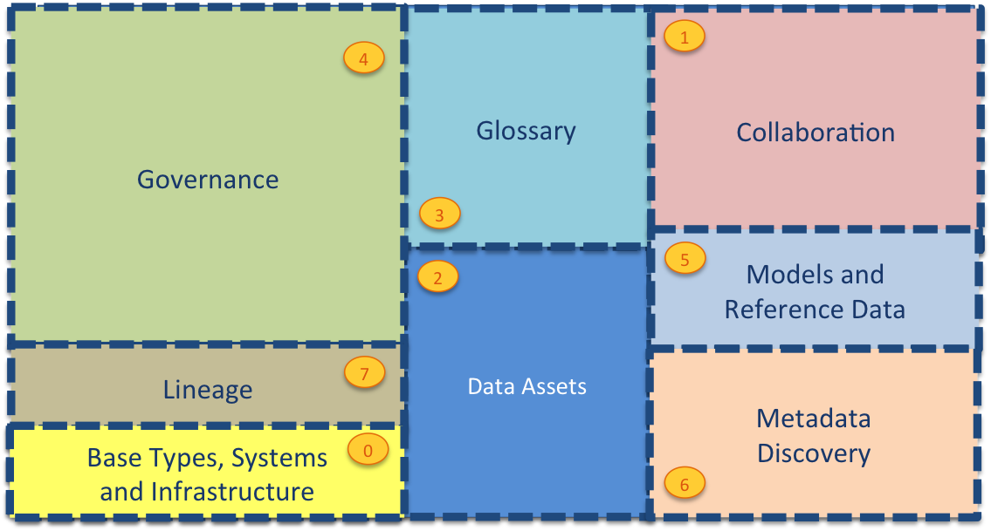
Current Open Metadata Access Services (OMASs)
Asset Consumer
Asset Owner
Asset Lineage
Subject Area
Asset Catalog
Community Profile
Stewardship Action
Project Management
Information View
Data Science
Governance Program
Software Developer
Data Privacy
Digital Architecture
Data Process
Data Protection
DevOps
Governance Engine
Data Infrastructure
Data Platform
Connected Asset
Discovery Engine

Slide 47
Governance Program OMAS
Interfaces
Governance Leadership
Governance Drivers
Governance Policy Making
Governance Specification
Governance Organization
Governance Rollout
Governance Review
Rights Management
Strategize
Design
Implement
Review

Slide 48
Subject Area OMAS
Business
metadata
IS-A
Employee
Sensitive
HAS-A
Work Location
HAS-A
HAS-A
Hourly Pay Rate
Manager
Compensation Plan
HAS-A
IS-A
HAS-A
Job Title
IS-A
HAS-A
Employee Id
Annual Salary
Employee Name
Structural
metadata for
a data store
EmpName
EmpNo
JobCode
Salary
Employee Record
Data
00 3809890 6 7 Lemmie Stage 818928 3082 4 New York 4 27 DataStage Expert 1 45324 300 27 Code St Harlem NY 1 3

Slide 49
Information View OMAS
Search
Out Topic
Data Virtualization
Gaian
Business View
Virtualizer
Information View OMAS
Logical Tables
Technical View
In Topic
Mapping Logic

Slide 50
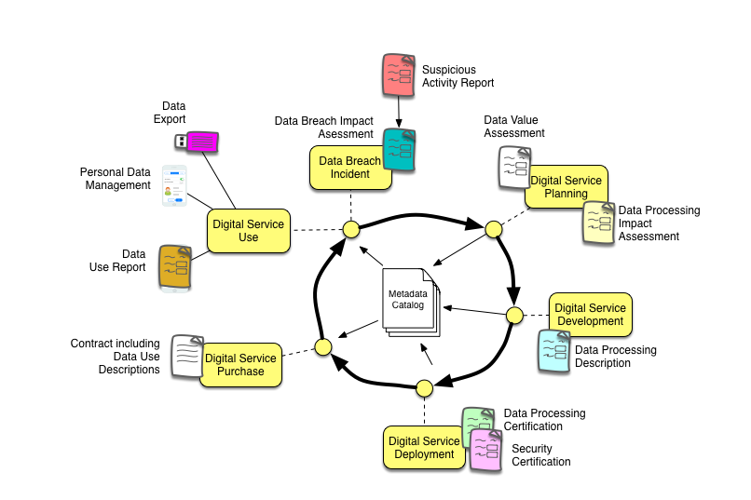
Digital Service Lifecycle

Slide 51
Compliance test philosophy and demo

Slide 52
Its an “imitation game”
Is this an open metadata server?
?
Compliance
Test

Slide 53
The repository connector’s metadata collection
Managing Type Definitions (TypeDefs)
Search and Query for metadata instances
Maintenance of metadata instances
Advanced maintenance
Maintenance of reference copies

Slide 54
Mandatory features
Support for at least one open metadata type:
Ability to exchange information the types supported by the repository using appropriate TypeDef and AttributeTypeDef structures.
Ability to create, update, delete, query and search for supported entities, classifications and relationships.
Ability to increment a version number within each metadata instance, each time it is changed.
Ability to ensure supported metadata instances conform to their type definition.

Slide 55
Optional features
Ability to programmatically create and maintain type definitions.
Ability to understand the relationships throughout the metadata using graph-like queries.
Ability to query the state of metadata from an historical point in time.
Ability to storing entity proxies as first class elements in the repository.
Ability to mark instances as deleted and restore them later. (soft-delete)
Ability to undo updates on metadata instances.
Ability to change the unique identifier (guid) of a metadata instance.
Ability to change the type of a metadata instance.
Ability to store and maintain reference copies of metadata from other open metadata repositories.

Slide 56
Compliance Testing
Code
Open Metadata Test Lab
Open Metadata Workbenches
Open Metadata Test Case
Compliance Report
Pass or fail
Discovered properties

Slide 57










ODPi - co-creation with practitioners
Compliance assistance and certification for vendors
Subject matter experts sharing best practices and co-creating content packs

Slide 58
Help wanted
Governance practice leaders needed to build out best practices
If you buy data technology please encourage your vendors to consume the Egeria technology.
Looking for developers:
UI development
Graph repository (eg JanusGraph/TinkerPop)
Python clients
Join the ODPi to help fund our work
Tell everyone about want we do

Slide 59
z
z
z
z
z
z
z
Questions?

Slide 60
Links
Data Privacy Pack
Coco Pharmaceuticals Persona
Open source repositories
https://github.com/odpi/data-governance/tree/master/webinars/july2018
https://odpi.github.io/data-governance/data-privacy-pack/
https://odpi.github.io/data-governance/coco-pharmaceuticals/personas/
https://odpi.github.io/data-governance/roles/
https://github.com/odpi/data-governance
https://github.com/odpi/egeria

Slide 61
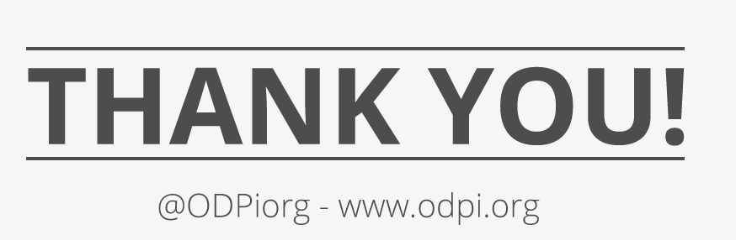

Slide 62
Adding a repository
You need to write the code in Yellow
Repository connector maps repository service (OMRS) calls to your repository calls (open to your format)
Event mapper connector maps your repository events* to call to the OMRS
Repository operation** request
Repository connector
Access services
Repository services
Your metadata server
Open format
your format
Repository operation response
***
Event mapper connector
OMRS topic
Publish to cohort
* Repository events include entity created, relationship deleted, entity classified
**Repository operations include CRUD for Entities and relationships and search
*** Call repository connector to get more information

